Slide 1

IBM SkillsBuild for Adult Learners - Data Analytics
Data Analytics Internship Program 2024 Final Project Presentation
Project Name :Analysing Tilt and Angle of Solar panels to predict optimal Tilt angle using
Machine Learning (SDG 7: Affordable and clean energy)
UniqueID : IBM0687 Team Name :Insight Illuminati
College Name :Cochin University of Science and Technology

Slide 2
Team Members
Pranav S
Unni Rengan
Diya Mirza K I
Ashna Shanavas
Vaishak C Krishnan

Slide 3
Introduction
Affordable and clean energy is largely dependent on solar energy.
The tilt angle of solar panels concerning the sun has a major impact on how much energy they can produce.
Conventionally, location-based static computations are employed, ignoring environmental and seasonal variations that have a major impact on efficiency.
This project suggests using machine learning (ML) to predict the ideal tilt for maximizing power production by analyzing solar panel tilt angle, environmental factors, and energy output.

Slide 4
Introduction
The objective of this project is to leverage the power of machine learning to optimize solar panel tilt angles and unlock their full potential for clean energy generation, directly contributing to Sustainable Development Goal 7 (SDG 7): Affordable and clean energy. Here's a more detailed breakdown of the project's objective:
Collect the datas
Create datasets from survey
Clean and preprocess dataset
Execute exploratory data analysis using different visualization techniques
Analyze the visualization
Develop a Predictive Model for Optimal Tilt Angle
Maximize Solar Energy Production
Contribute to SDG 7

Slide 5
Problem Identification
Inadequacy of Current Methods:
- The current methods for determining solar panel tilt angles are largely based on static calculations that use a location's latitude. This approach does not adequately capture the dynamic nature of solar energy generation.
Ignoring Dynamic Factors:
- Static calculations fail to consider seasonal variations in the sun's path, as well as changing weather conditions such as cloud cover, dust storms, and temperature fluctuations. These factors significantly impact the efficiency of solar panels.
Suboptimal Energy Production:
- As a result of using fixed tilt angles that do not adapt to changing conditions, the energy production from solar panels is often suboptimal. This hinders the ability to fully utilize solar energy as a clean and affordable alternative.

Slide 6
Data Collection
Solar farms & research institutions: They might share anonymized data on tilt angle and energy output.
Open-source datasets: Platforms like NREL, NASA POWER, and World Bank offer solar and weather data.
Weather stations & government agencies: They provide historical and real-time weather data.
The chosen source depends on factors like data availability, granularity, quality, and accessibility

Slide 7
Data Preprocessing
Clean the data to ensure consistency and address missing values or outliers.
Format the data into a suitable structure for machine learning algorithms.
Feature engineering might be necessary to create additional features from existing data that could improve model performance

Slide 8
Data Analysis
Python: For data cleaning, analysis, and visualization, using libraries such as Pandas, NumPy, Matplotlib, and Seaborn.
Jupyter Notebooks: For documenting the analysis process and visualizations.
Scikit-learn: For developing predictive models and machine learning algorithms.

Slide 9
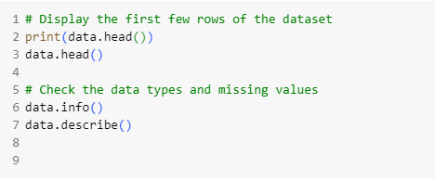
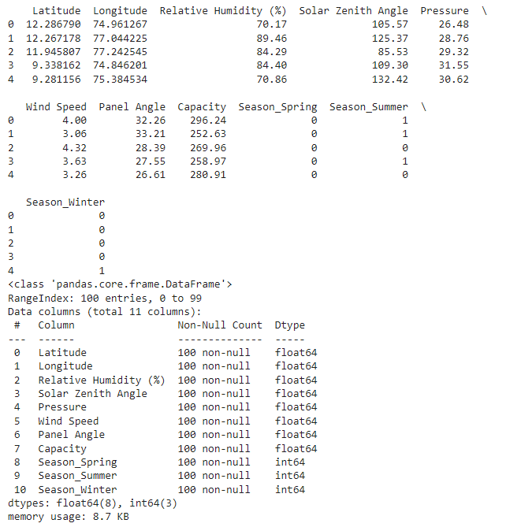
Data Analysis

Slide 10
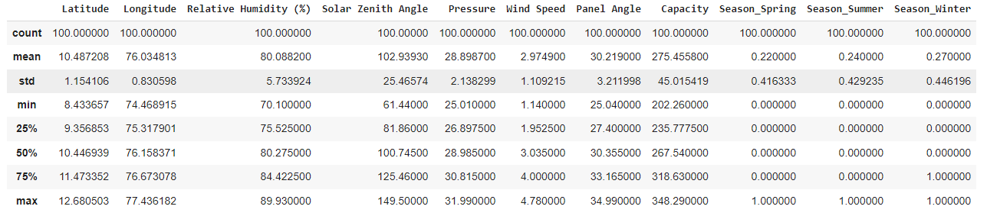
Data Analysis

Slide 11
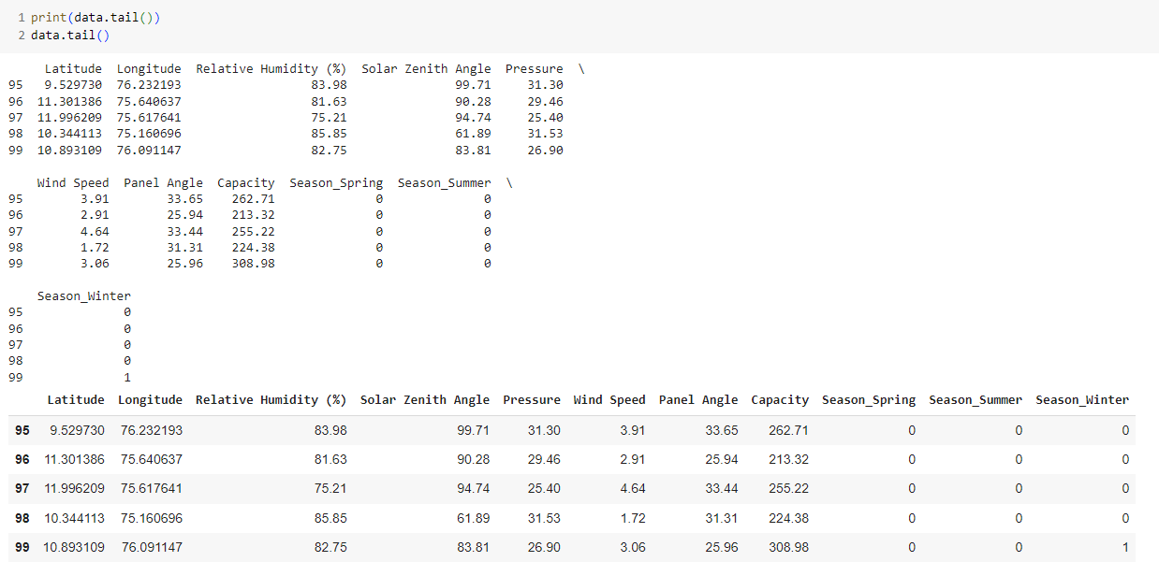
Data Analysis

Slide 12
Hypothesis Development
By developing a machine learning model that analyzes historical data on solar panel tilt angles, energy output, and environmental factors, we can predict the optimal tilt angle for a specific location, leading to significantly increased solar energy production compared to traditional, statically calculated tilt angles.
This hypothesis suggests that a data-driven, dynamic approach to tilt angle determination can outperform the limitations of current static methods.
By accounting for seasonal variations, weather conditions, and other environmental factors, the machine learning model is expected to identify the optimal tilt angle that maximizes sunlight capture and, consequently, energy generation.

Slide 13
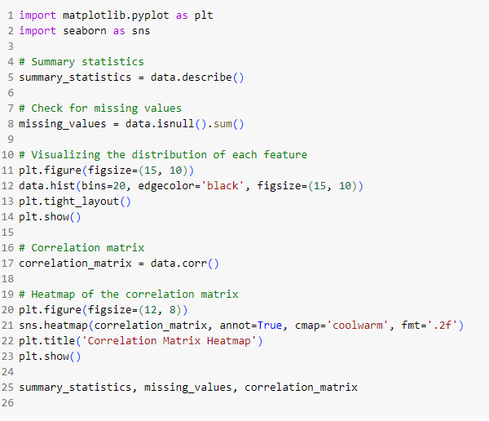
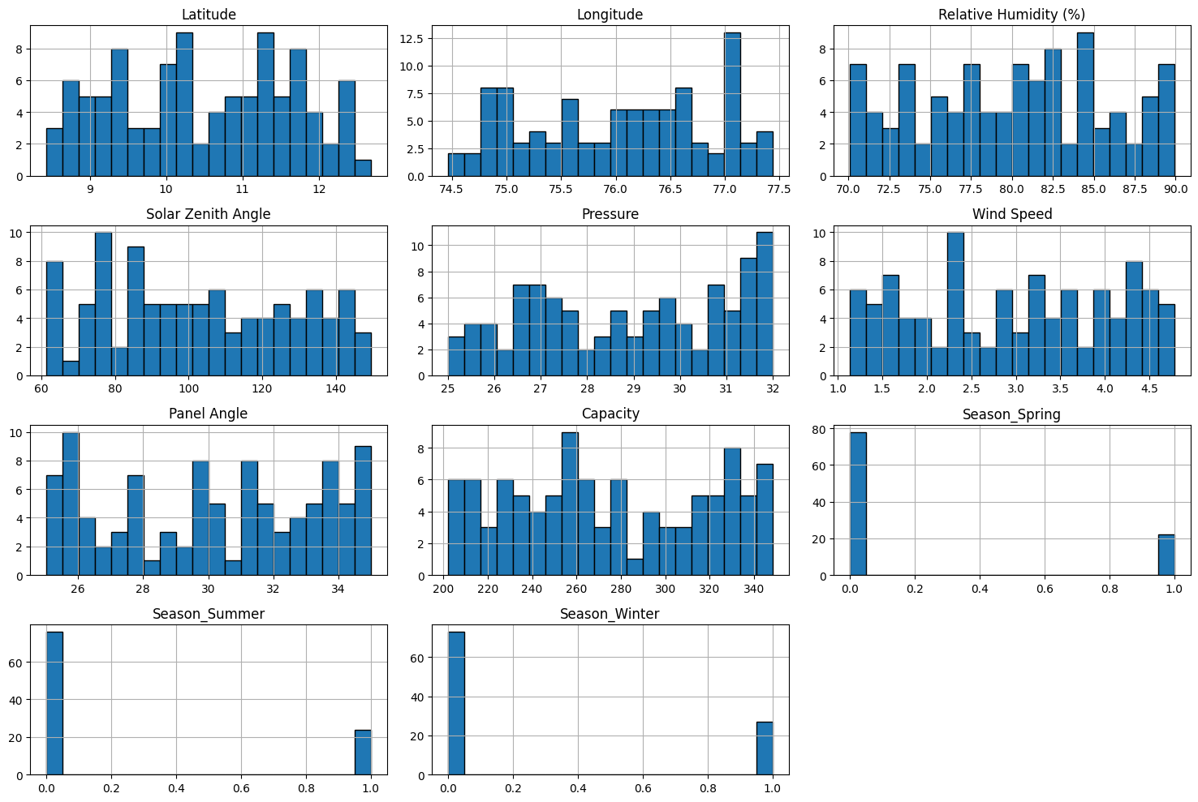
Visualization

Slide 14
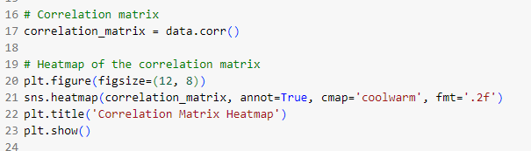
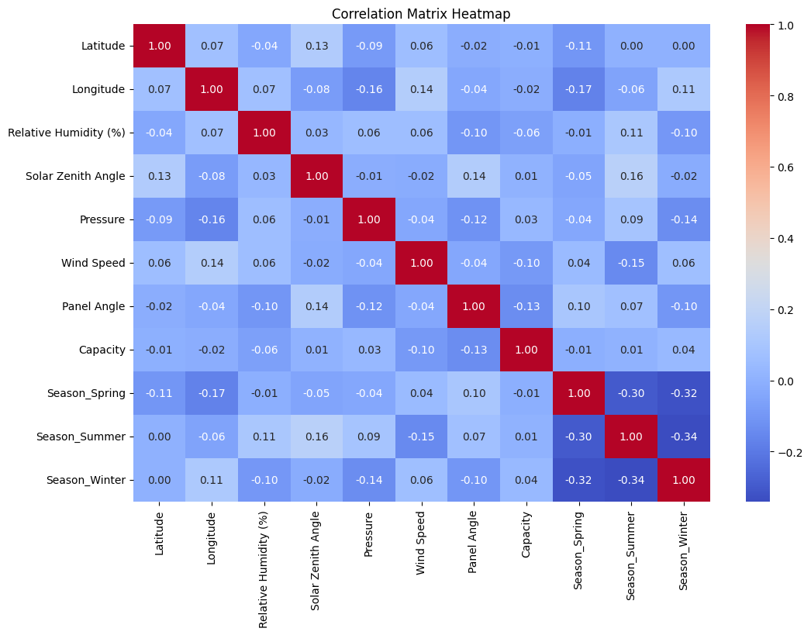
Visualization

Slide 15
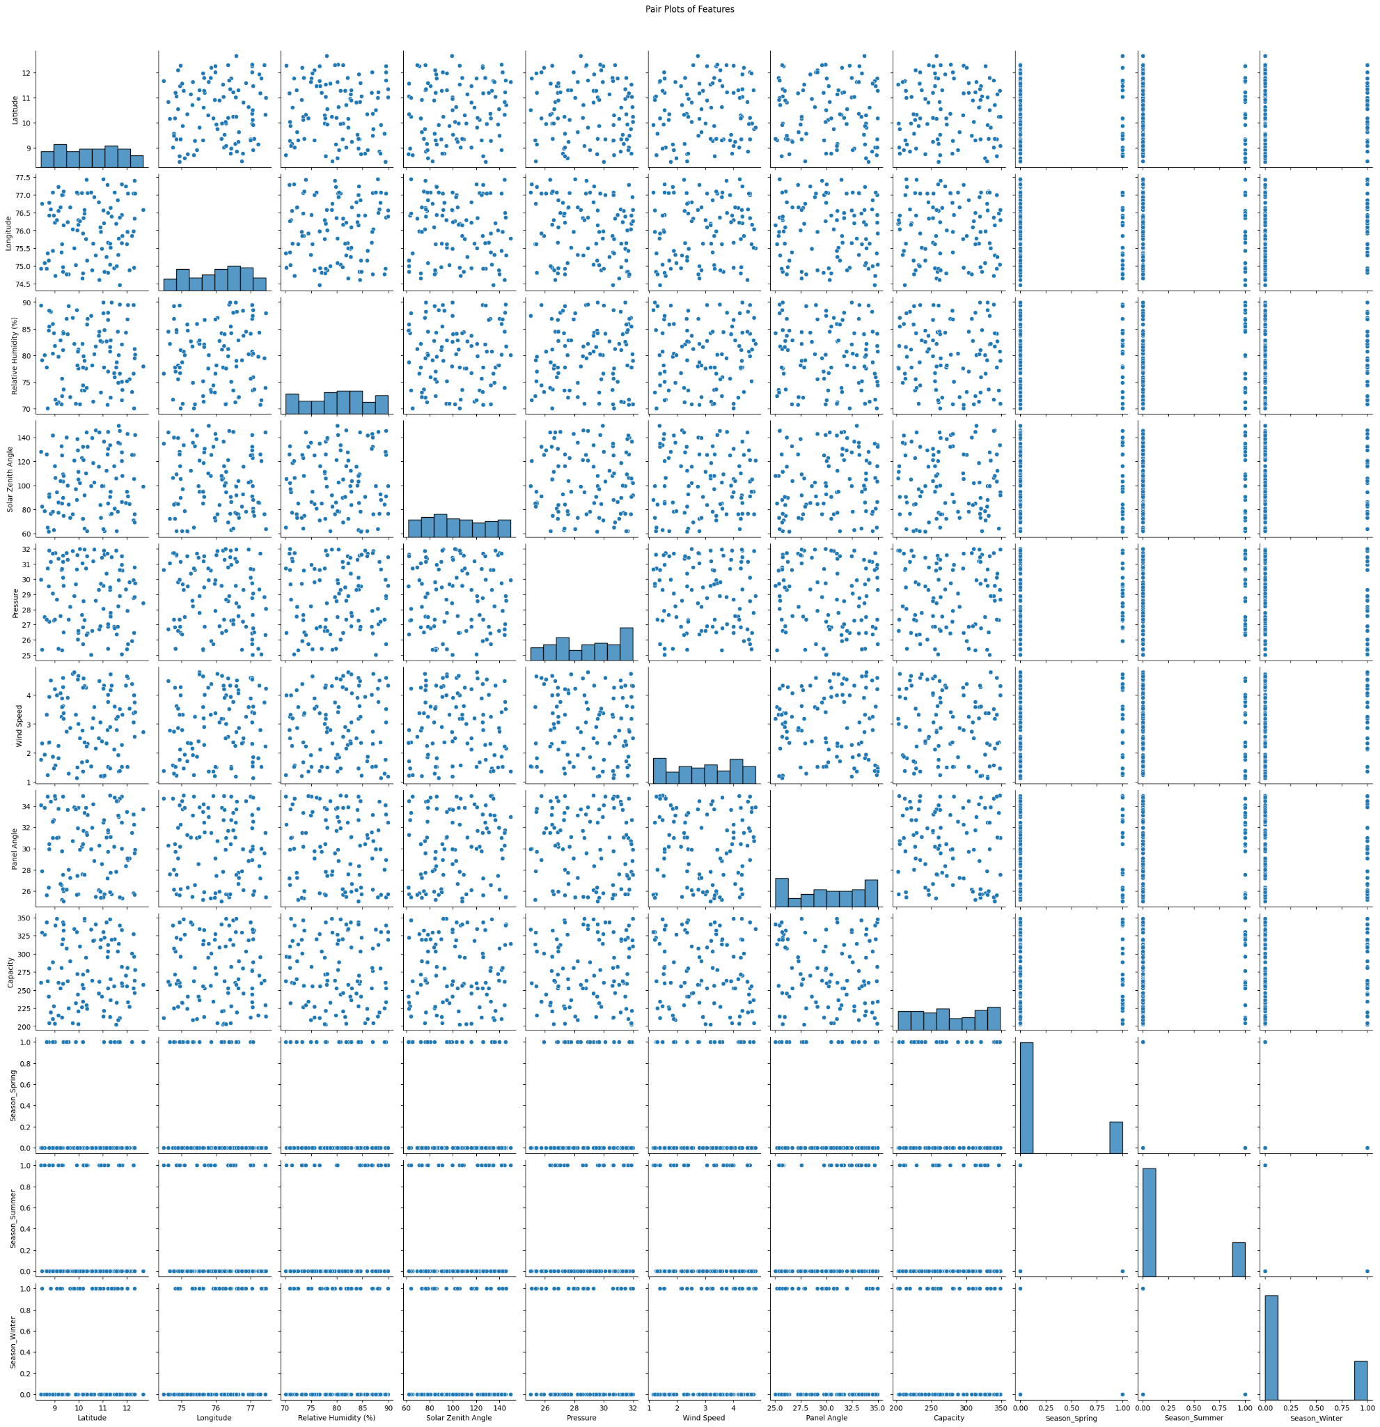
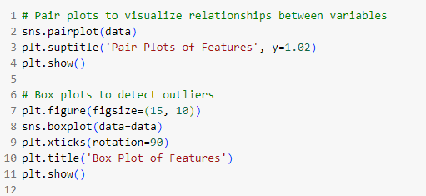
Visualization

Slide 16
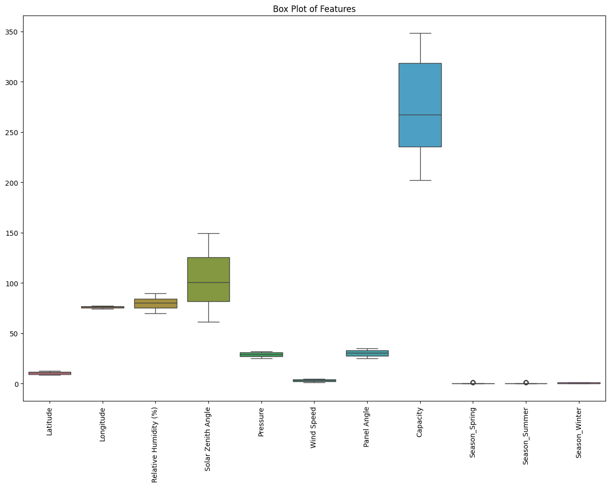
Visualization

Slide 17
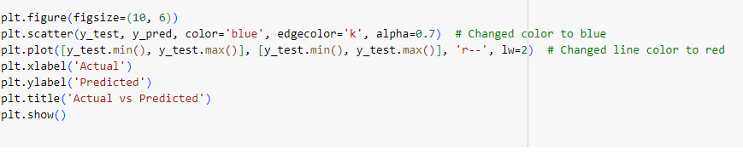
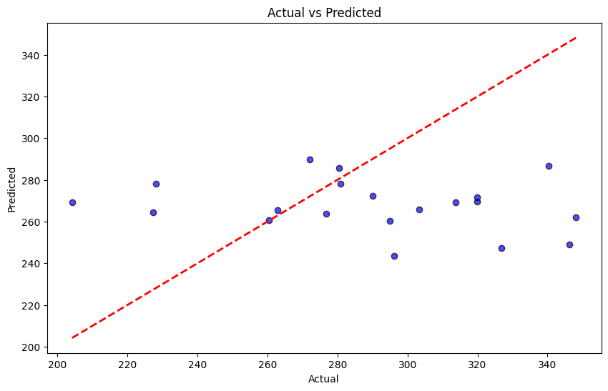
Visualization

Slide 18
Solution Design
Inadequate Methodology:
Current methods rely on static calculations based on latitude.
Lack of Dynamic Consideration:
These methods do not account for the dynamic nature of solar energy generation.
Seasonal Variation Neglect:
They fail to consider seasonal changes in the sun's path.
Weather Condition Oversight:
Important factors like cloud cover, dust storms, and temperature fluctuations are not considered.
Inefficient Energy Production:
The use of fixed tilt angles leads to suboptimal energy output, limiting the potential of solar energy as a clean and affordable alternative.

Slide 19
Conclusion
Powerful Prediction Model:
Develop a machine-learning model that analyzes historical data on solar panel tilt angles, energy output, and environmental factors
Train the model to predict the optimal tilt angle for each location, maximizing sunlight capture and energy generation throughout the year.
Boosting Clean Energy (SDG 7):
Predicting optimal tilt angles significantly increases solar energy production compared to static methods.
This translates to more efficient solar panels and a cleaner energy source, directly contributing to SDG 7: Affordable and clean energy.
Potential benefits include:
Lower energy costs for consumers
Increased access to clean energy in underserved areas
Reduced reliance on fossil fuels and their climate impact

Slide 20
References
Data for this project can come from various sources:
Solar farms & research institutions: They might share anonymized data on tilt angle and energy output.
Open-source datasets: Platforms like NREL, NASA POWER, and World Bank offer solar and weather data.
Weather stations & government agencies: They provide historical and real-time weather data.
The chosen source depends on factors like data availability, granularity, quality, and accessibility.

Slide 21
References
The following tools and technologies will be used for data analysis:
Python
Jupyter Notebooks
Pandas
Matplotlib
seaborn
Scikit-learn(sklearn)

Slide 22
References
The following tools and technologies will be used for data analysis:
Python
Jupyter Notebooks
Pandas
Matplotlib
seaborn
Scikit-learn(sklearn)

